Slide 1
BEGAN: Boundary Equilibrium Generative Adversarial Networks
(Reference:- arXiv: 1703.10717, 2017)

Slide 2
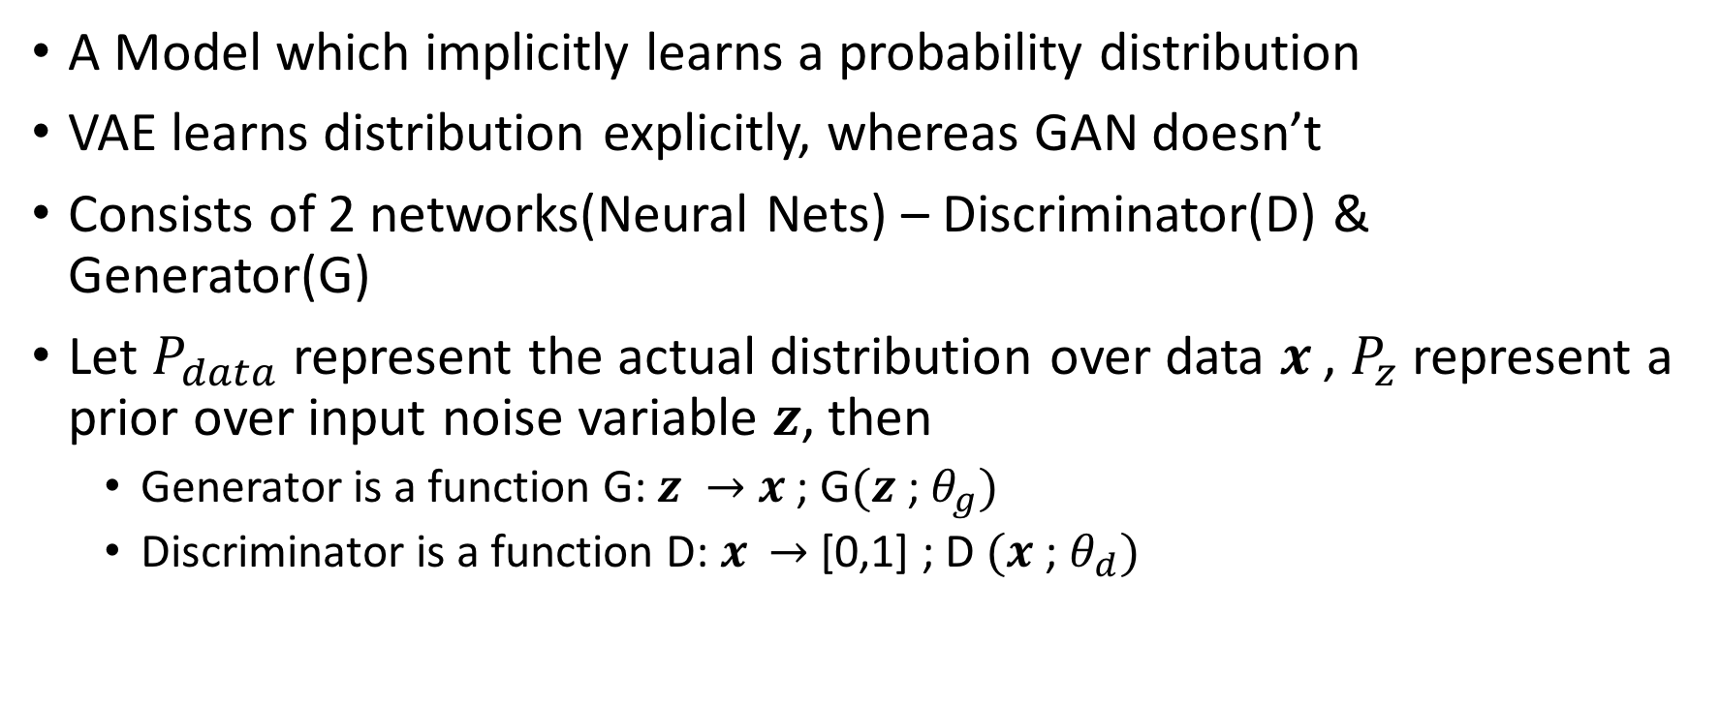
What is a GAN(Generative Adversarial Network)?
A Model which implicitly learns a probability distribution
VAE learns distribution explicitly, whereas GAN doesn’t
Consists of 2 networks(Neural Nets) – Discriminator(D) & Generator(G)
Let $P_{data}$ represent the actual distribution over data $x^{ }$, $P_{z}$ represent a prior over input noise variable $z$, then
Generator is a function G: $z →$ $x^{ }$; G$(z$; $θ_{g})$
Discriminator is a function D: $x^{ }$ $→$ [0,1] ; D $(x$; $θ_{d})$

Slide 3
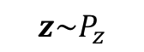
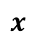
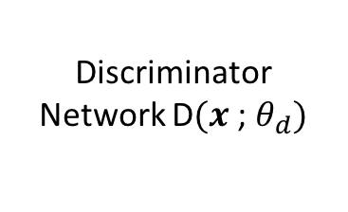
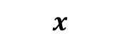
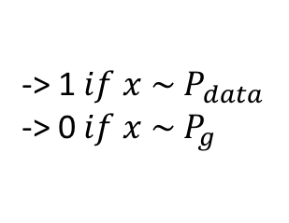
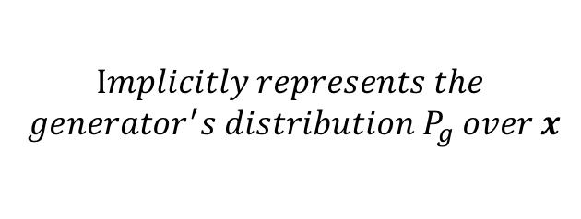
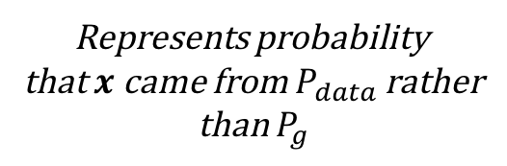
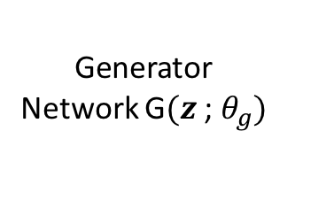
$$Implicitly represents the$$
$$generator^{′}s distribution P_{g} over x$$
Generator Network G$(z$; $θ_{g})$
$$z\sim P_{z}$$
$x$
Represents probability
that $x$ came from $P_{data}$ rather
than $P_{g}$
Discriminator Network D$(x$; $θ_{d})$
-> 1 $if x \sim P_{data}$
-> 0 $if x \sim P_{g}$
$$x$$

Slide 4
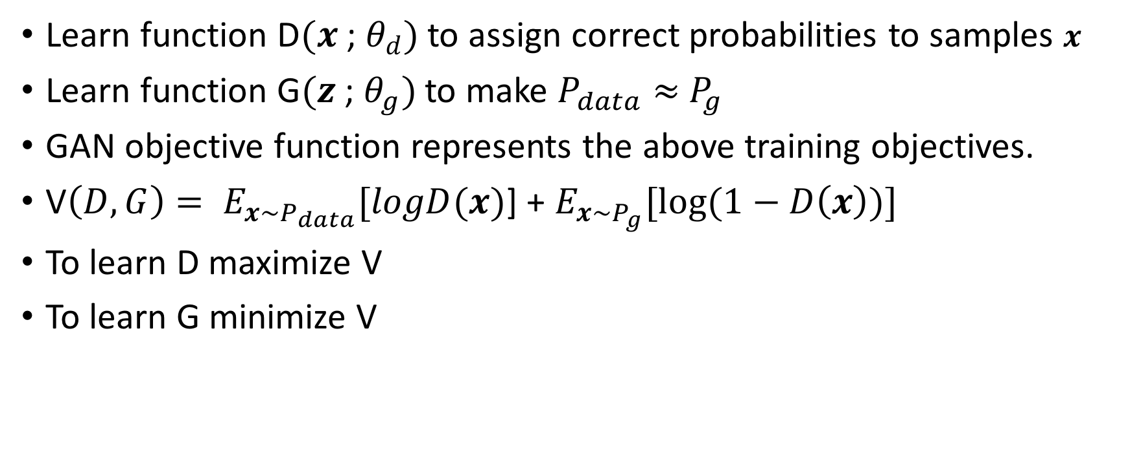
GAN Objective Function
Learn function D$(x$; $θ_{d})$ to assign correct probabilities to samples $x$
Learn function G$(z$; $θ_{g})$ to make $P_{data}$ $≈$ $P_{g}$
GAN objective function represents the above training objectives.
V$\left(D,G\right)= E_{x\sim P_{data}}[logD(x)$] + $E_{x\sim P_{g}}[log⁡(1−D\left(x\right))]$
To learn D maximize V
To learn G minimize V

Slide 5
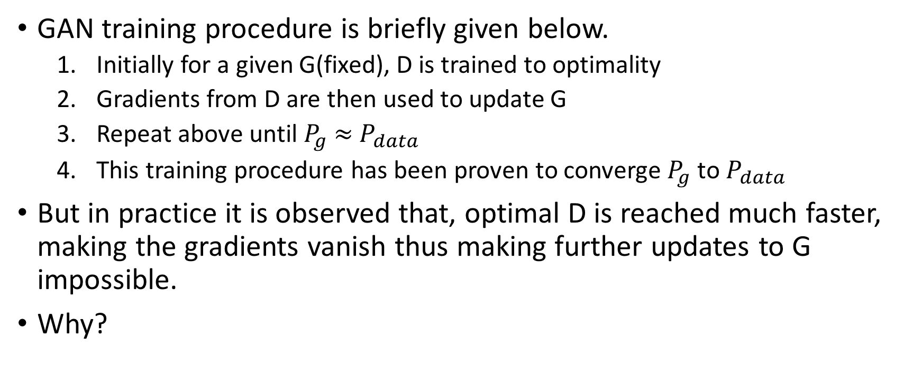
Training GAN
GAN training procedure is briefly given below.
Initially for a given G(fixed), D is trained to optimality
Gradients from D are then used to update G
Repeat above until $P_{g}$ $≈$ $P_{data}$
This training procedure has been proven to converge $P_{g}$ to $P_{data}$
But in practice it is observed that, optimal D is reached much faster, making the gradients vanish thus making further updates to G impossible.
Why?

Slide 6
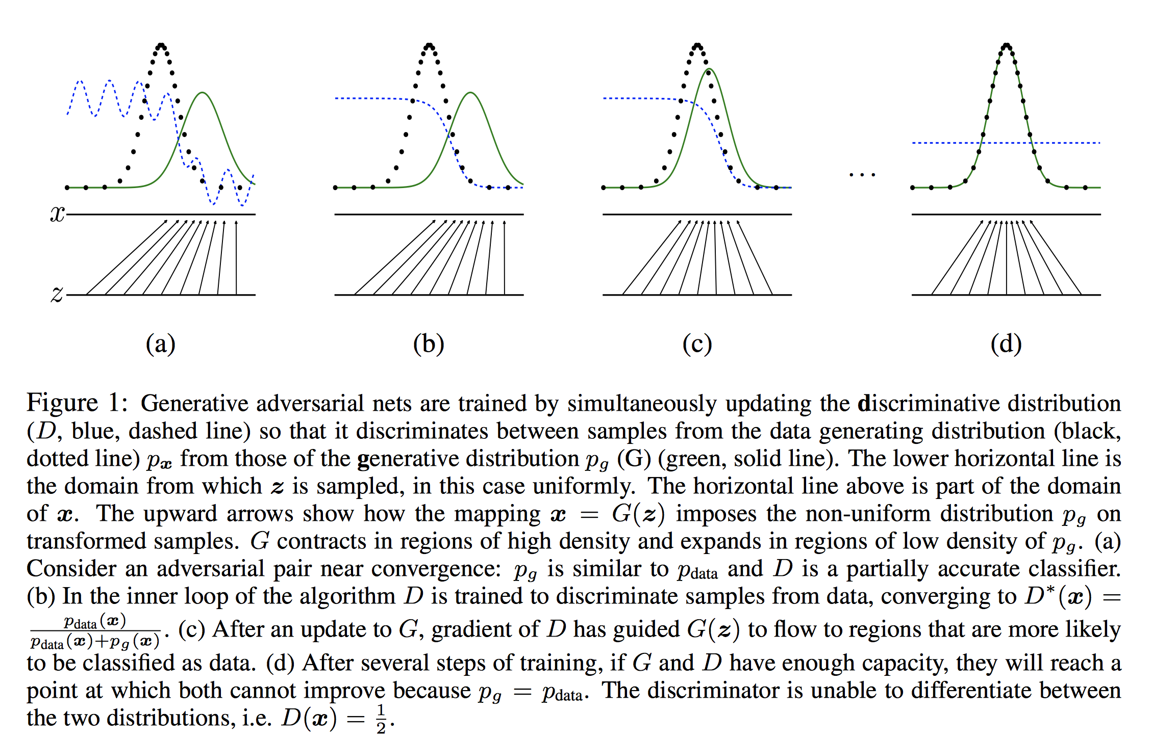

Slide 7
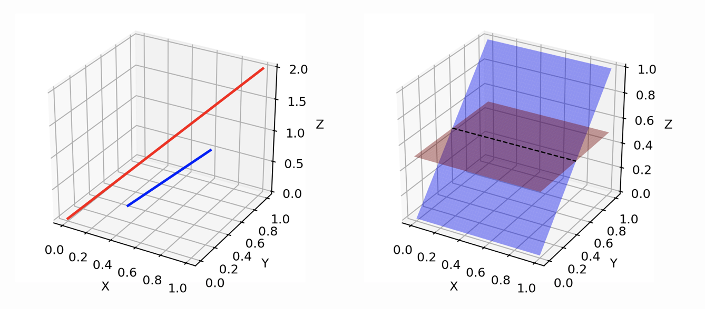
Low-dimensional Manifolds in Higher Space

Slide 8
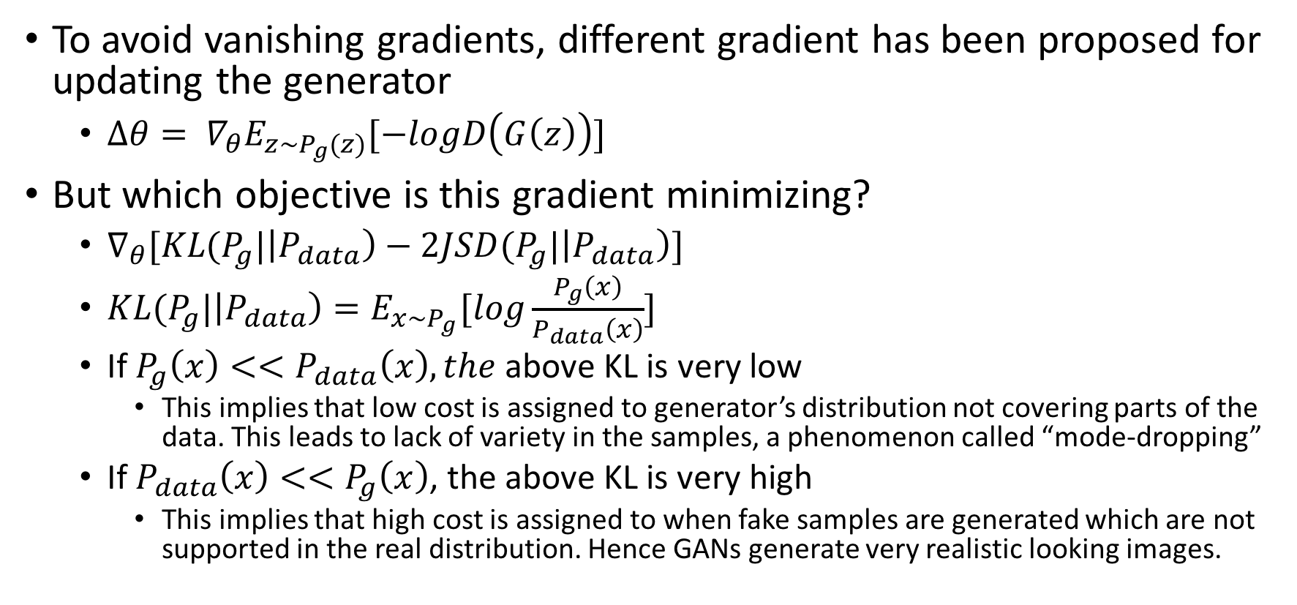
Other GAN training problems
To avoid vanishing gradients, different gradient has been proposed for updating the generator
$∆θ= ∇_{θ}E_{z\sim P_{g}(z)}[−logD\left(G\left(z\right)\right)]$
But which objective is this gradient minimizing?
$∇_{θ}[KL(P_{g}|\left|P_{data}\right)−2JSD(P_{g}|\left|P_{data}\right)]$
$KL(P_{g}|\left|P_{data}\right)=E_{x\sim P_{g}}[log\frac{P_{g}\left(x\right)}{P_{data}\left(x\right)}]$
If $P_{g}\left(x\right)<<P_{data}\left(x\right), the$ above KL is very low
This implies that low cost is assigned to generator’s distribution not covering parts of the data. This leads to lack of variety in the samples, a phenomenon called “mode-dropping”
If $P_{data}\left(x\right)<<P_{g}\left(x\right)$, the above KL is very high
This implies that high cost is assigned to when fake samples are generated which are not supported in the real distribution. Hence GANs generate very realistic looking images.

Slide 9
Root Cause
Also there is no clear convergence measure to stop training. Usually samples are visually verified(to see if modal collapse)/no of epochs measured.
To avoid the discussed issues, GAN based on Wasserstein distance has been proposed.
Though this solves many of the problems, it is extremely slow to train.
We go back to the root-cause of the original GAN training issue – the difficulty in synchronizing D & G training.
Most of the times Discriminator wins too easily in the beginning of the training.
BEGAN is one proposed solution to impose an equilibrium between Discriminator and Generator.

Slide 10
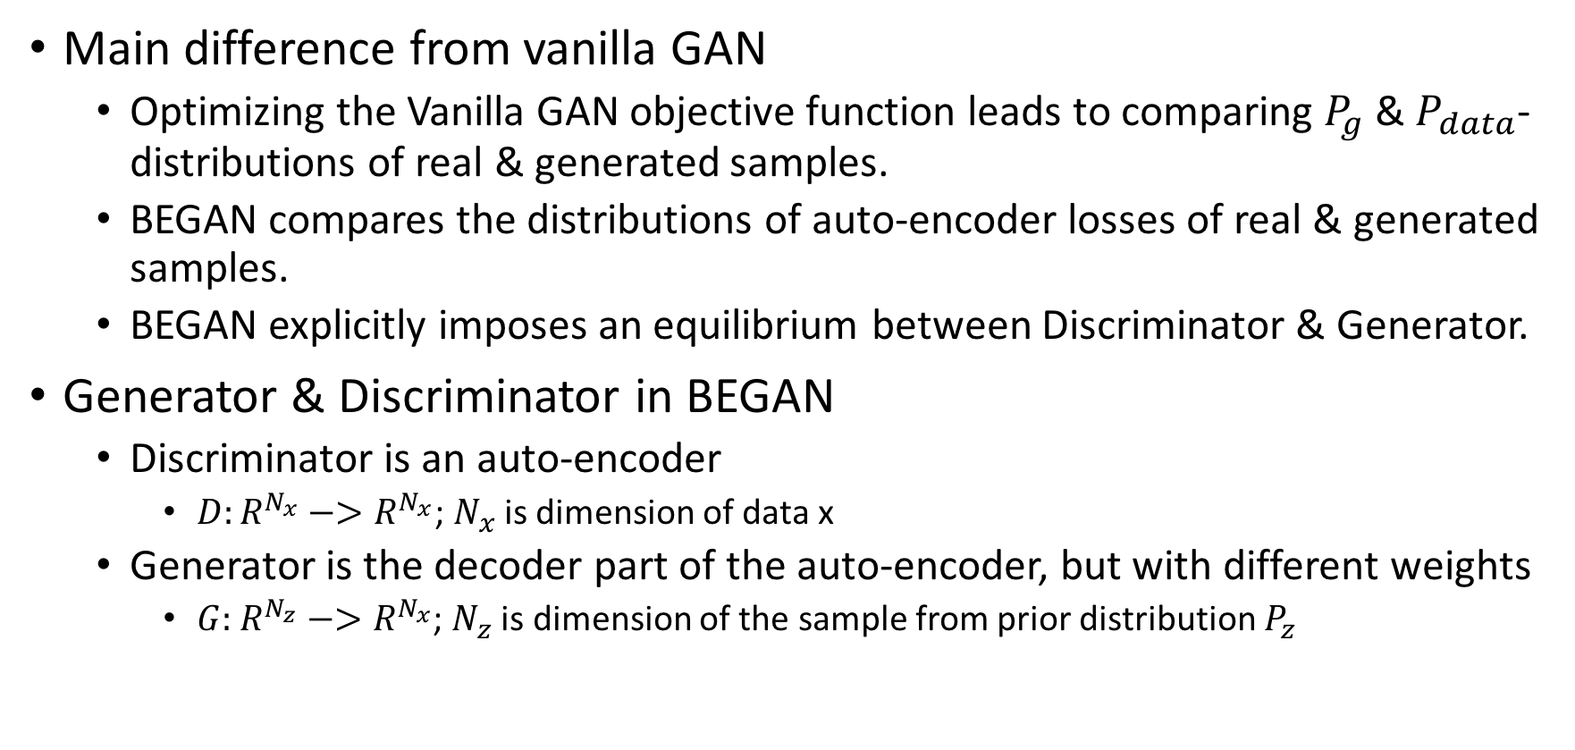
BEGAN(Boundary Equilibrium GAN)
Main difference from vanilla GAN
Optimizing the Vanilla GAN objective function leads to comparing $P_{g}$ & $P_{data}$- distributions of real & generated samples.
BEGAN compares the distributions of auto-encoder losses of real & generated samples.
BEGAN explicitly imposes an equilibrium between Discriminator & Generator.
Generator & Discriminator in BEGAN
Discriminator is an auto-encoder
$D:R^{N_{x}}−>R^{N_{x}}$; $N_{x}$ is dimension of data x
Generator is the decoder part of the auto-encoder, but with different weights
$G:$ $R^{N_{z}}−>R^{N_{x}}$; $N_{z}$ is dimension of the sample from prior distribution $P_{z}$

Slide 11
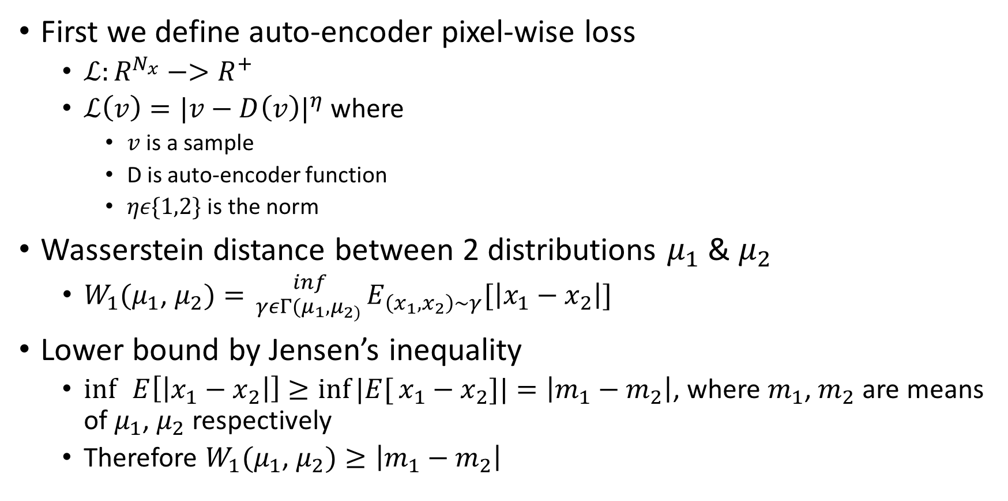
Wasserstein Distance Lower bound
First we define auto-encoder pixel-wise loss
$ℒ:R^{N_{x}}−>R^{+}$
$ℒ\left(v\right)={|v−D\left(v\right)|}^{η}$ where
$v$ is a sample
D is auto-encoder function
$ηε\{1,2\}$ is the norm
Wasserstein distance between 2 distributions $μ_{1}$ & $μ_{2}$
$W_{1}(μ_{1}$, $μ_{2})= _{γεΓ(μ_{1},μ_{2)}}^{ inf}E_{\left(x_{1},x_{2}\right)\sim γ}[\left|x_{1}−x_{2}\right|]$
Lower bound by Jensen’s inequality
$\inf{ }E\left[\left|x_{1}−x_{2}\right|\right]≥\inf{|E[}x_{1}−x_{2}]|=\left|m_{1}−m_{2}\right|$, where $m_{1}$, $m_{2}$ are means of $μ_{1}$, $μ_{2}$ respectively
Therefore $W_{1}(μ_{1}$, $μ_{2})≥\left|m_{1}−m_{2}\right|$

Slide 12
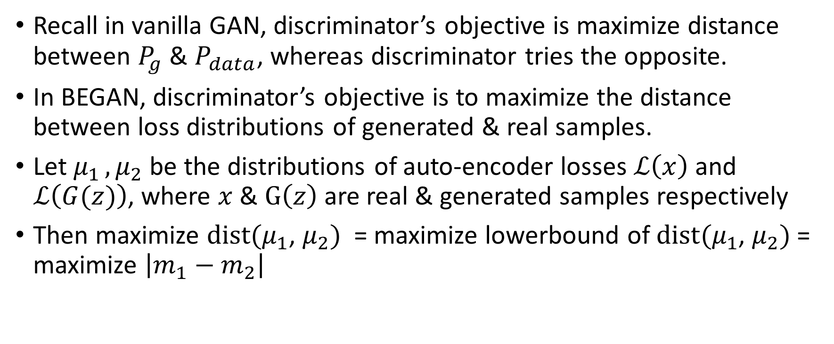
GAN Objective
Recall in vanilla GAN, discriminator’s objective is maximize distance between $P_{g}$ & $P_{data}$, whereas discriminator tries the opposite.
In BEGAN, discriminator’s objective is to maximize the distance between loss distributions of generated & real samples.
Let$μ_{1 },μ_{2}$ be the distributions of auto-encoder losses $ℒ\left(x\right)$ and $ℒ\left(G(z)\right)$, where $x$ & $G\left(z\right)$ are real & generated samples respectively
Then maximize $dist(μ_{1}$, $μ_{2})$ = maximize lowerbound of $dist(μ_{1}$, $μ_{2})$ = maximize $\left|m_{1}−m_{2}\right|$

Slide 13
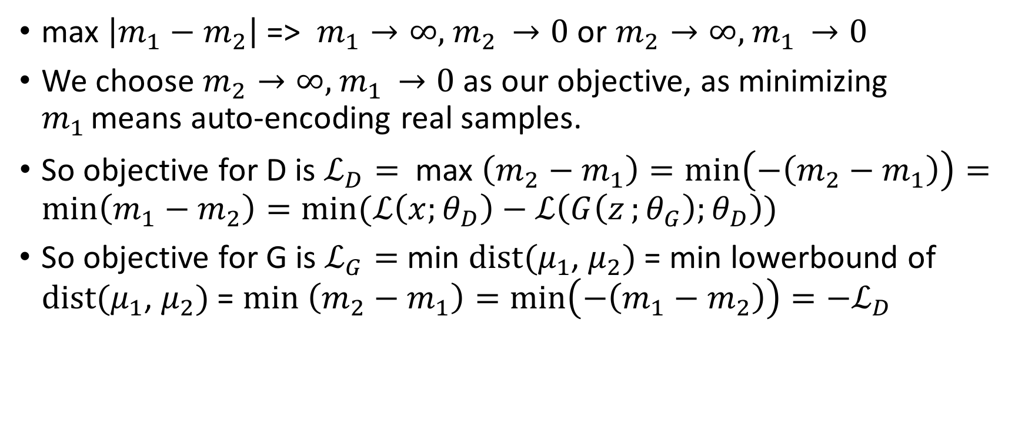
GAN Objective (cont)
max $\left|m_{1}−m_{2}\right|$ => $m_{1}→∞,$ $m_{2 }→0$ or $m_{2}→∞,$ $m_{1 }→0$
We choose $m_{2}→∞,$ $m_{1 }→0$ as our objective, as minimizing $m_{1 }$means auto-encoding real samples.
So objective for D is $ℒ_{D}=$ max $\left(m_{2}−m_{1}\right)=\min\left(−\left(m_{2}−m_{1}\right)\right)=\min\left(m_{1}−m_{2}\right)=min⁡(ℒ\left(x;θ_{D}\right)−ℒ\left(G\left(z_{ };θ_{G}\right);θ_{D}\right))$
So objective for G is $ℒ_{G}=$ min $dist(μ_{1}$, $μ_{2})$ = min lowerbound of $dist(μ_{1}$, $μ_{2})$ = $min \left(m_{2}−m_{1}\right)=\min\left(−\left(m_{1}−m_{2}\right)\right)=−ℒ_{D}$

Slide 14
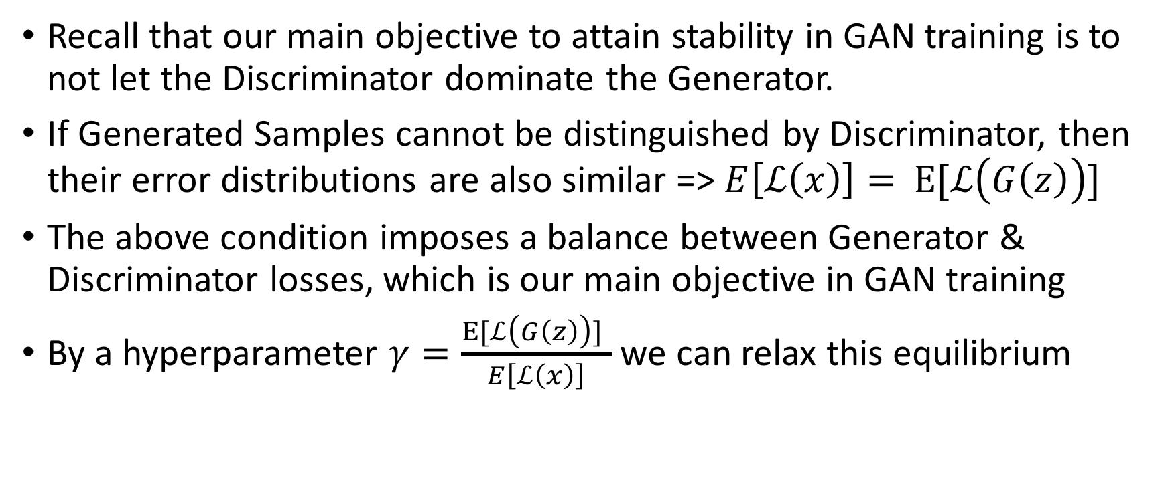
Equilibrium
Recall that our main objective to attain stability in GAN training is to not let the Discriminator dominate the Generator.
If Generated Samples cannot be distinguished by Discriminator, then their error distributions are also similar => $E\left[ℒ\left(x\right)\right]=$ $E[ℒ\left(G\left(z\right)\right)]$
The above condition imposes a balance between Generator & Discriminator losses, which is our main objective in GAN training
By a hyperparameter $γ=\frac{E[ℒ\left(G\left(z\right)\right)] }{E\left[ℒ\left(x\right)\right]}$ we can relax this equilibrium

Slide 15
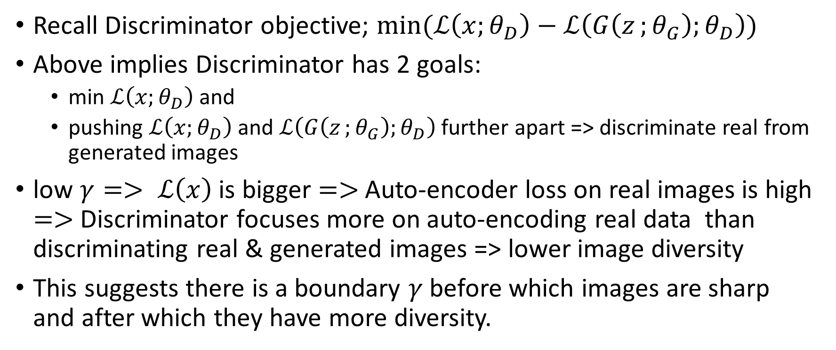
Equilibrium(cont)
Recall Discriminator objective; $min⁡(ℒ\left(x;θ_{D}\right)−ℒ\left(G\left(z_{ };θ_{G}\right);θ_{D}\right))$
Above implies Discriminator has 2 goals:
min $ℒ\left(x;θ_{D}\right)$ and
pushing $ℒ\left(x;θ_{D}\right)$ and $ℒ\left(G\left(z_{ };θ_{G}\right);θ_{D}\right)$ further apart => discriminate real from generated images
low $γ=> ℒ\left(x\right)$ is bigger $=>$Auto-encoder loss on real images is high $=>$Discriminator focuses more on auto-encoding real data than discriminating real & generated images => lower image diversity
This suggests there is a boundary $γ$ before which images are sharp and after which they have more diversity.

Slide 16
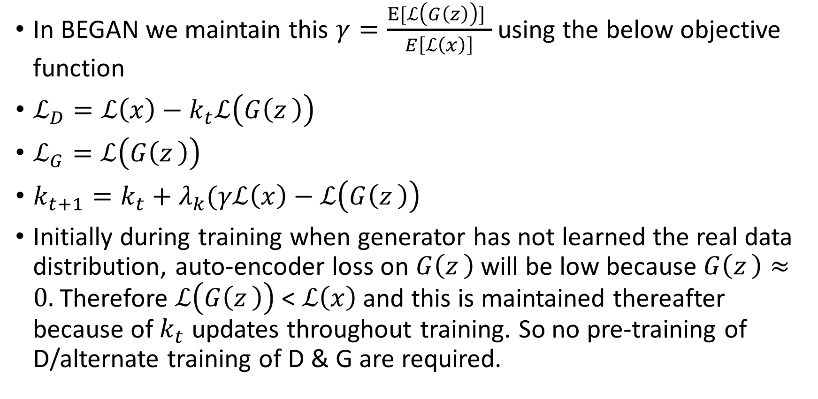
Boundary Equilibrium
In BEGAN we maintain this $γ=\frac{E[ℒ\left(G\left(z\right)\right)] }{E\left[ℒ\left(x\right)\right]}$ using the below objective function
$ℒ_{D}=ℒ\left(x\right)−k_{t}ℒ\left(G\left(z_{ }\right)\right)$
$ℒ_{G}=ℒ\left(G\left(z_{ }\right)\right)$
$k_{t+1}=k_{t}+λ_{k}(γℒ\left(x\right)−ℒ\left(G\left(z_{ }\right)\right)$
Initially during training when generator has not learned the real data distribution, auto-encoder loss on $G\left(z_{ }\right)$ will be low because $G\left(z_{ }\right)≈0.$Therefore $ℒ\left(G\left(z_{ }\right)\right)$ < $ℒ\left(x\right)$ and this is maintained thereafter because of $k_{t}$ updates throughout training. So no pre-training of D/alternate training of D & G are required.

Slide 17
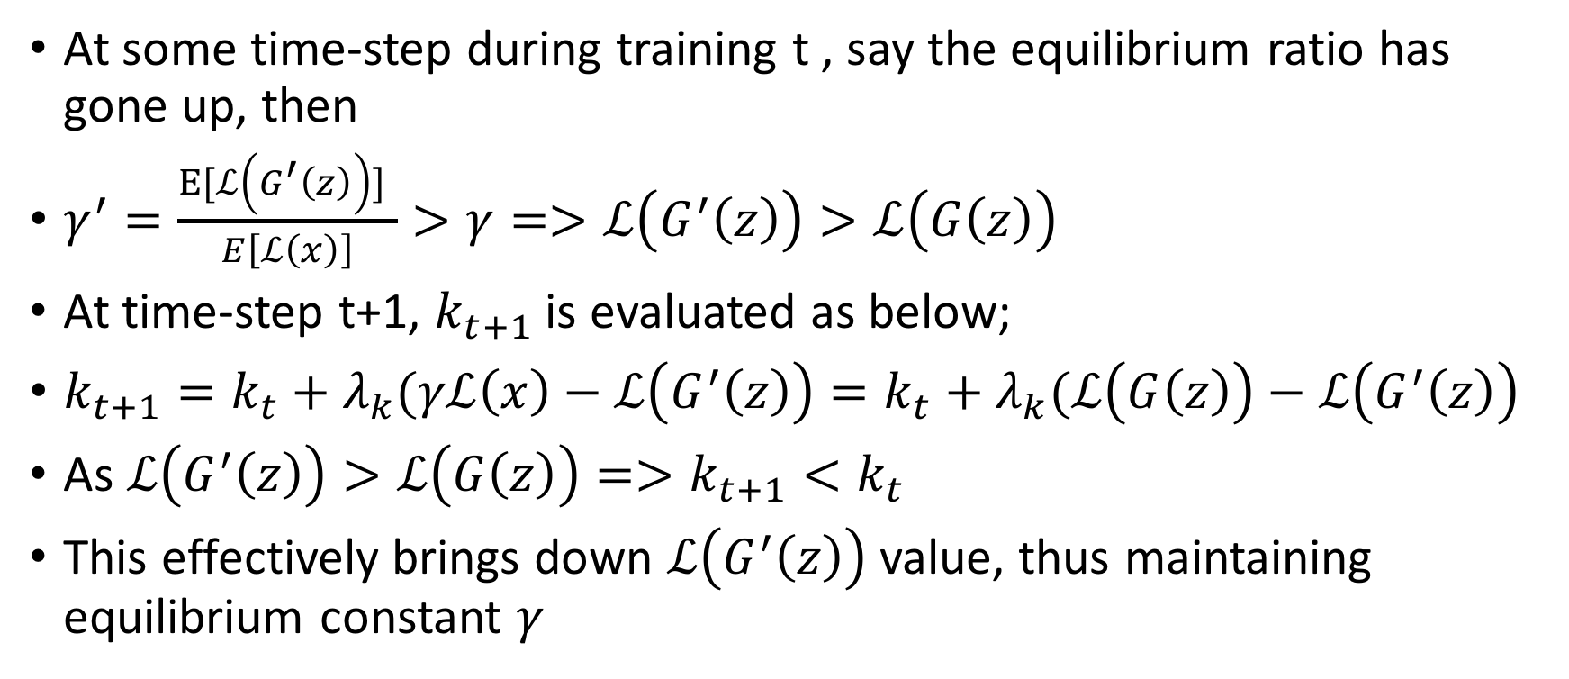
Feedback loop to maintain Equilibrium const
At some time-step during training t , say the equilibrium ratio has gone up, then
$γ^{′}=\frac{E[ℒ\left(G^{′}\left(z\right)\right)] }{E\left[ℒ\left(x\right)\right]}>γ=>ℒ\left(G^{′}\left(z\right)\right)>ℒ\left(G\left(z\right)\right)$
At time-step t+1, $k_{t+1}$ is evaluated as below;
$k_{t+1}=k_{t}+λ_{k}(γℒ\left(x\right)−ℒ\left(G^{′}\left(z\right)\right)=k_{t}+λ_{k}(ℒ\left(G\left(z\right)\right)−ℒ\left(G^{′}\left(z\right)\right)$
As $ℒ\left(G^{′}\left(z\right)\right)>ℒ\left(G\left(z\right)\right)=>k_{t+1}<k_{t}$
This effectively brings down $ℒ\left(G^{′}\left(z\right)\right)$ value, thus maintaining equilibrium constant $γ$

Slide 18
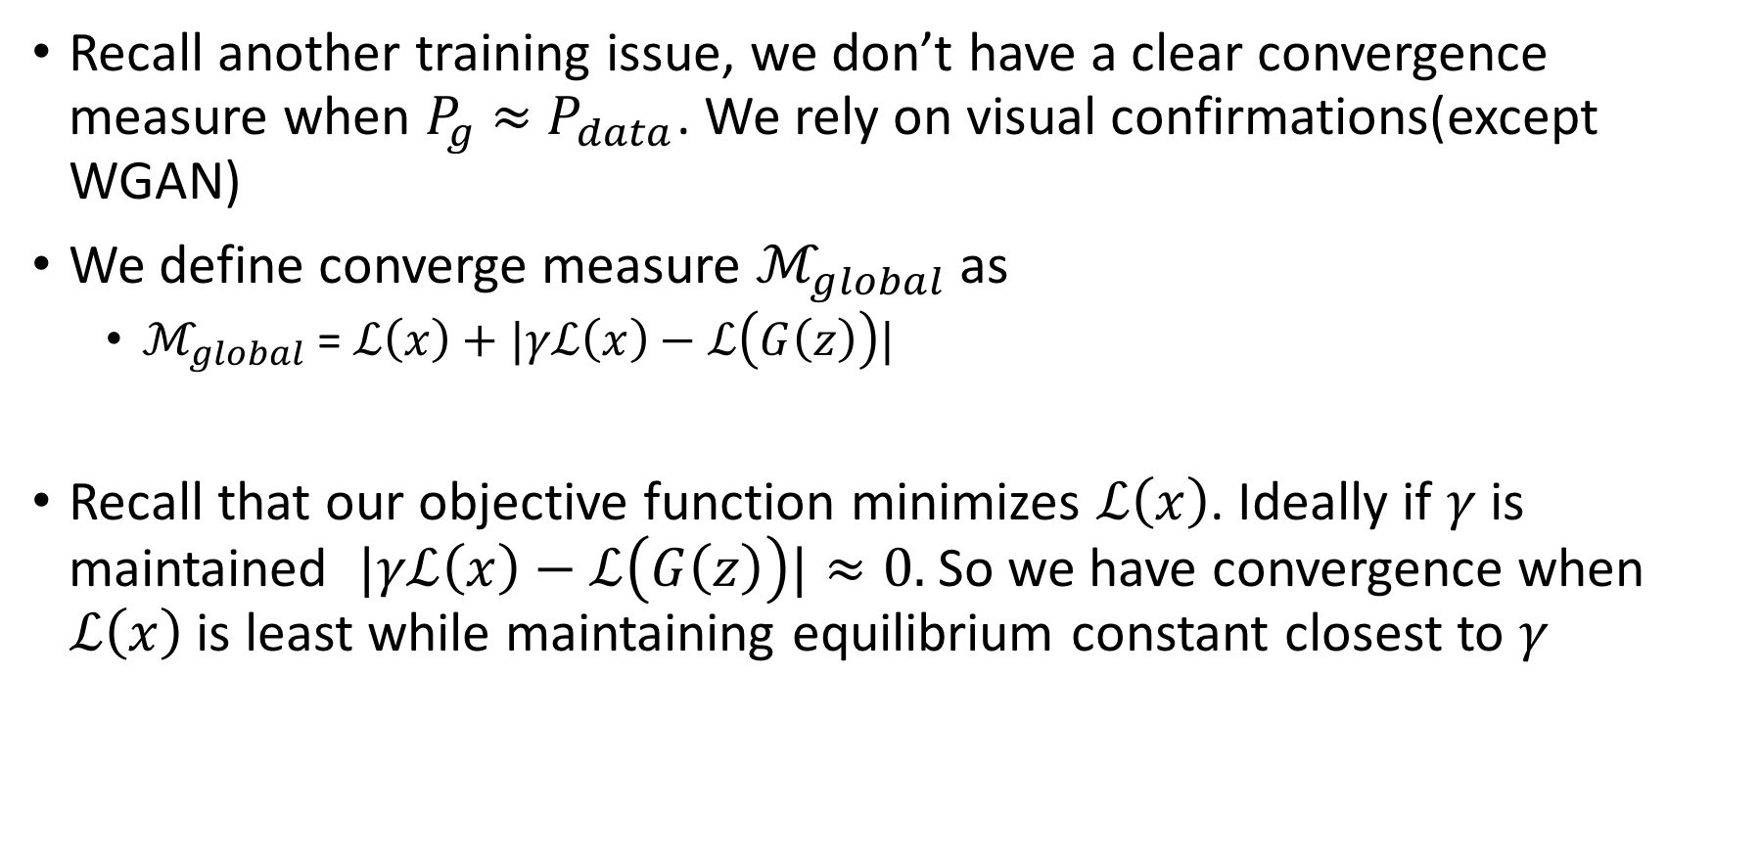
Convergence Measure
Recall another training issue, we don’t have a clear convergence measure when $P_{g}$ $≈$ $P_{data}$. We rely on visual confirmations(except WGAN)
We define converge measure $ℳ_{global}$ as
$ℳ_{global}$ = $ℒ\left(x\right)+|γℒ\left(x\right)−ℒ\left(G\left(z\right)\right)|$
Recall that our objective function minimizes $ℒ\left(x\right)$. Ideally if $γ$is maintained $|γℒ\left(x\right)−ℒ\left(G\left(z\right)\right)|≈0.$ So we have convergence when $ℒ\left(x\right)$ is least while maintaining equilibrium constant closest to $γ$

Slide 19
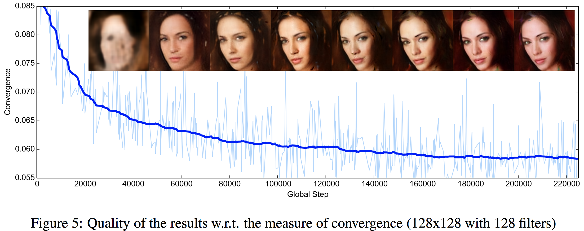

Slide 20
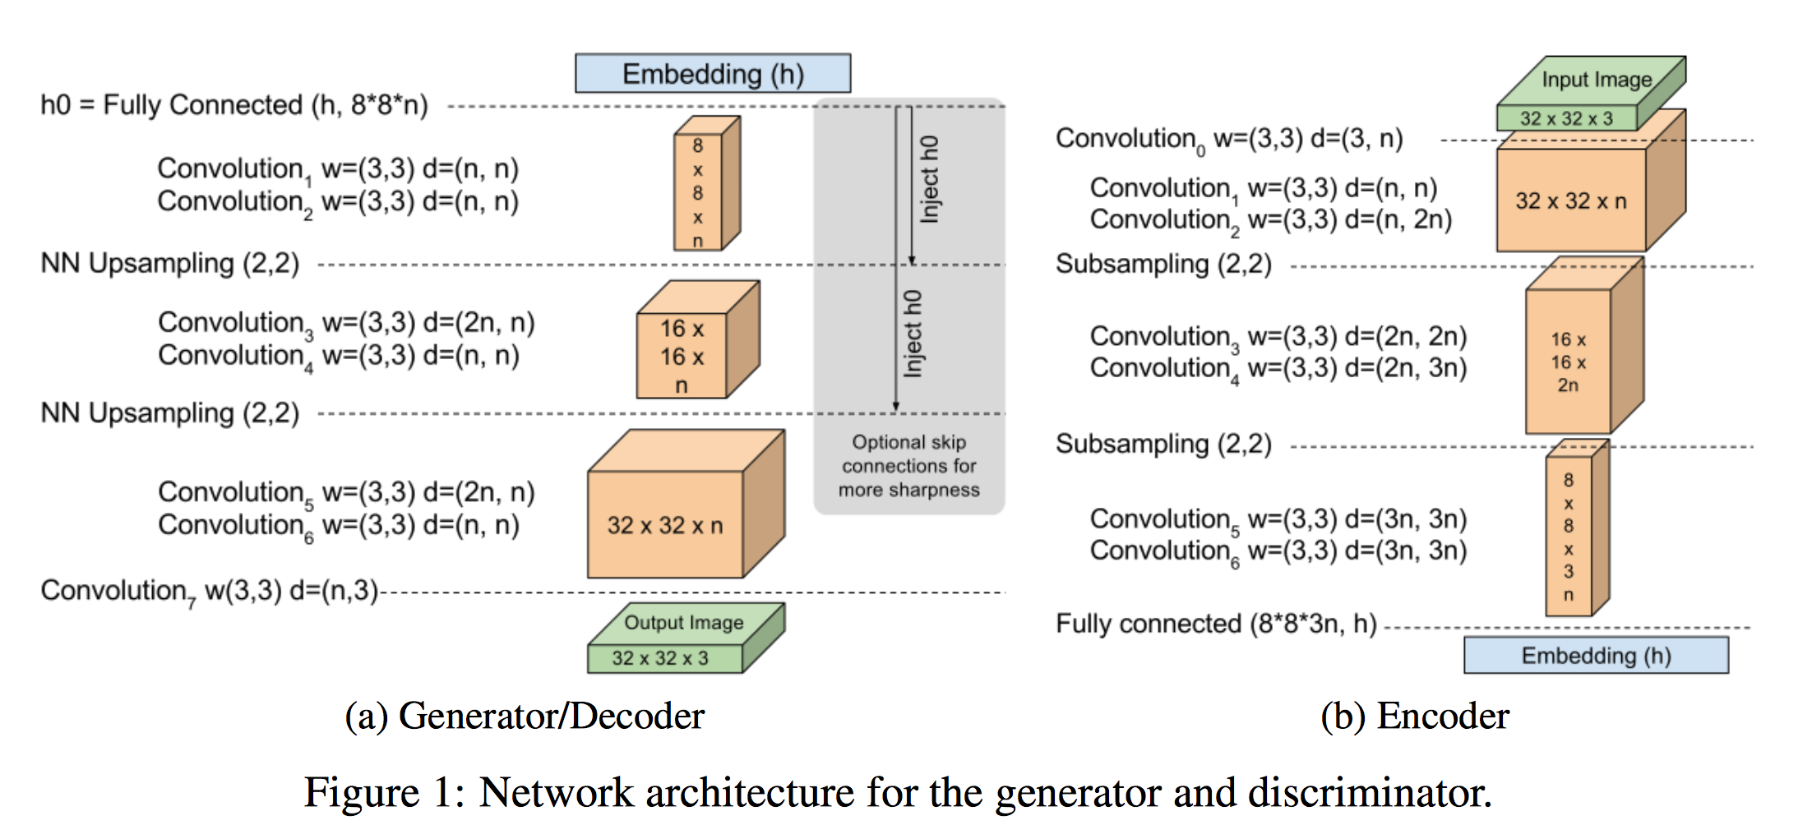
Model Architecture

Slide 21
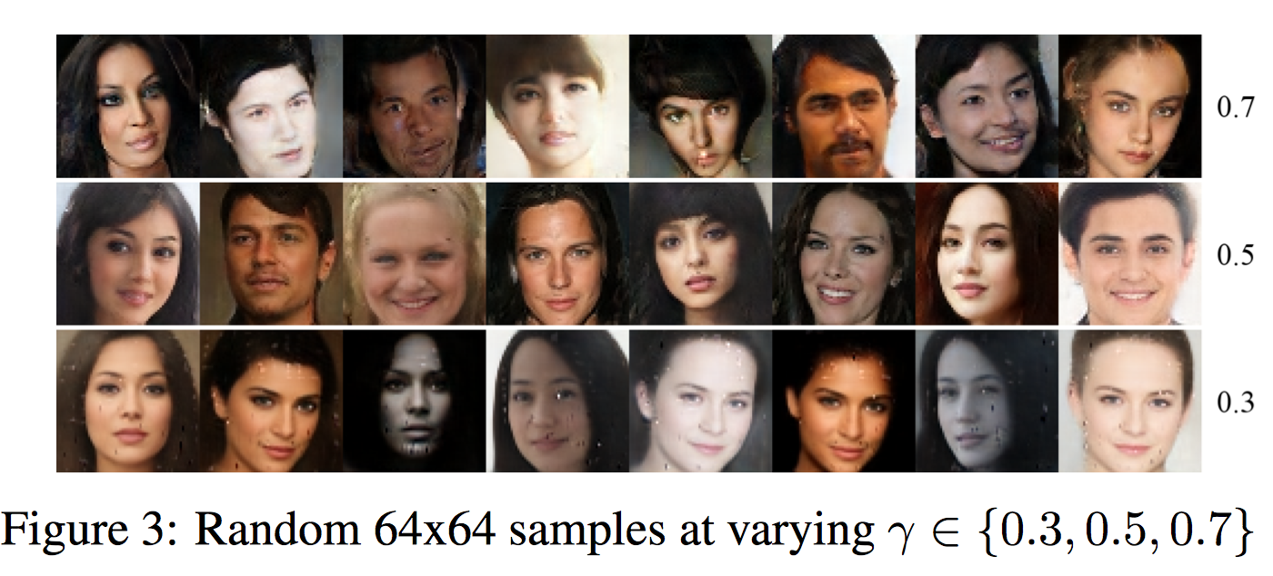
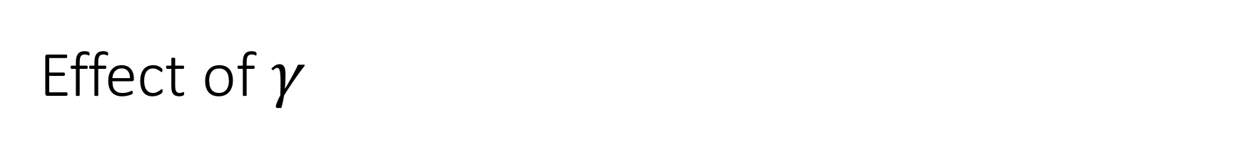
Effect of $γ$

Slide 22
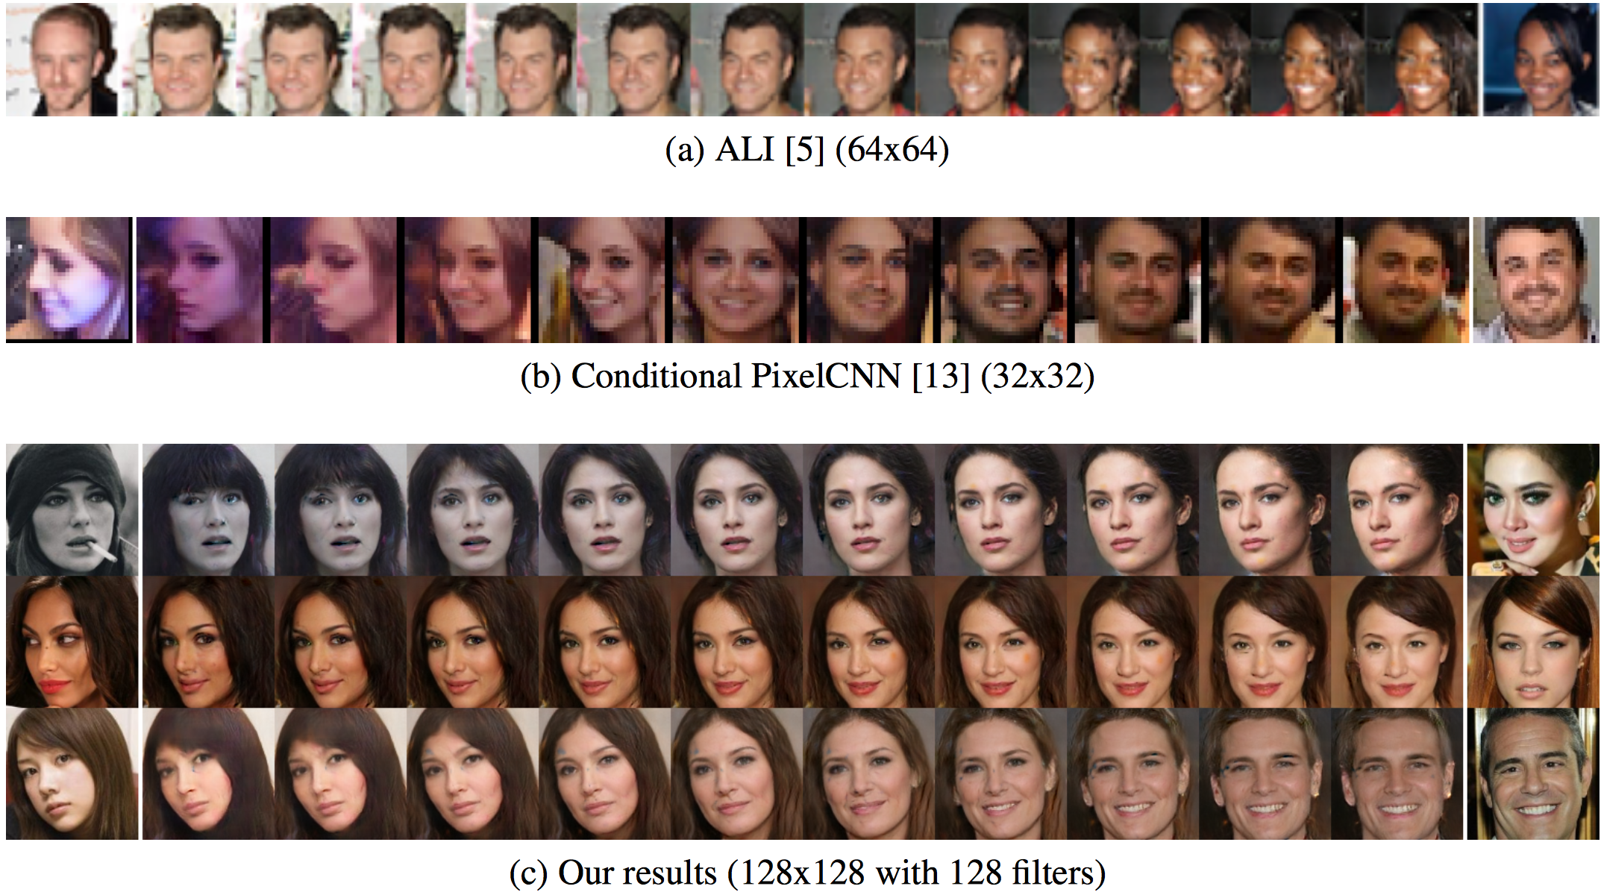
Space Continuity

Slide 23
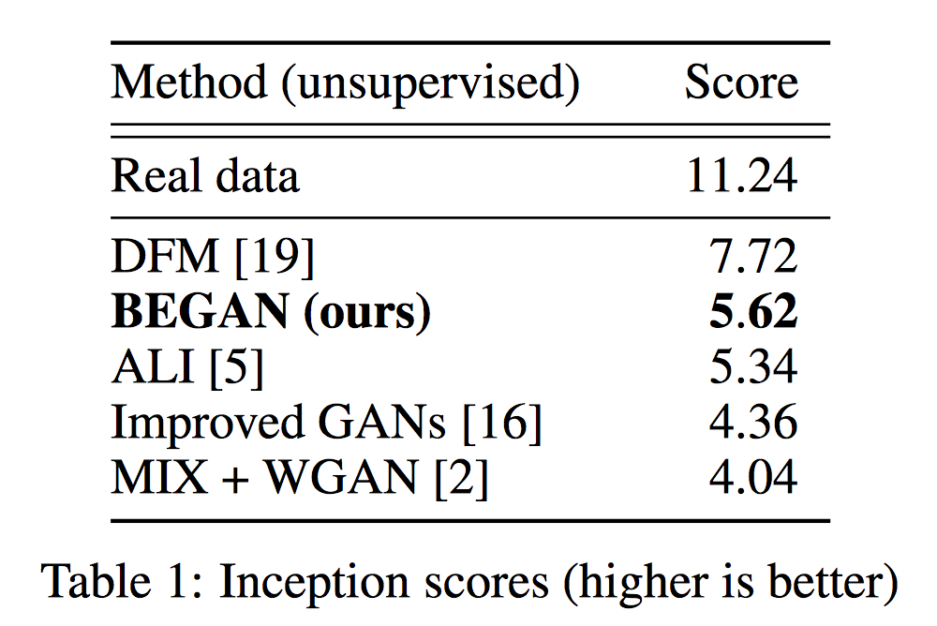
Inception Score

Slide 24
References
Material for GAN training problems is referred from arXiv:1701.04862,2017
Material for BEGAN is referred from arXiv:1703.10717, 2017

